Slide 1

Requirements Engineering
HTW Berlin
Thomas Berger/ May 2023

Slide 2
Recap
Thomas Berger
What is a use scenario
What is a wireframe
Why is prototyping important

Slide 3
2. Translate Product Requirements into Technical Requirements

Slide 4
Agenda – Translate Product Requiements into Technical Requirements
1
Technical Specification
2
Top-Down Approach from System Overview to Software Requirements
3
Interface Specification
4
Software Requirement Specification
5
Case Study – BIOTRONIK www.promricheck.com
6
Requirement Engineering in Agile Environment
7
Change Process

Slide 5

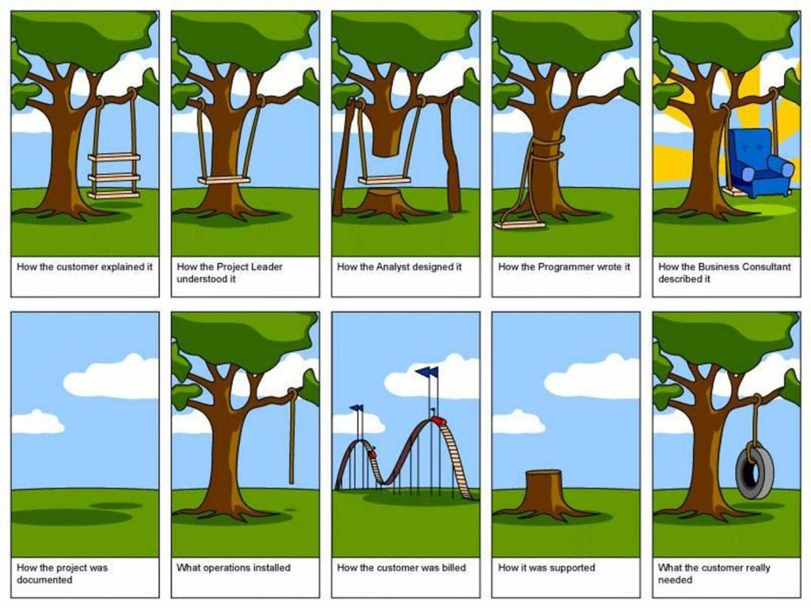







Technical Specification Document describes an actual solution
Idea
customer perspective
Stakeholder, customer agree on…
PRD
Description Technical solution
TSD
Product team designs...
Product
Product team develops...

Slide 6
Technical Specification Document
TSD
Contains…
Title & author information
Revision information
Purpose and scope (which parts or systems are specified within this document, e.g. software, hardware, the system, interfaces,…)
References (PRD, other TSD for interface, software, etc.)
User/ Actors
System Overview and Supported platforms
Requirements, including
functional requirements
Interfaces
Non-functional requirements
Cybersecurity
…
Tracing matrix in the System-TSD (which shows the tracing from all PRD requirements to the corresponding TSD requirements)

Slide 7
Agenda – Translate Product Requiements into Technical Requirements
1
Technical Specification
2
Top-Down Approach from System Overview to Software Requirements
3
Interface Specification
4
Software Requirement Specification
5
Case Study – BIOTRONIK www.promricheck.com
6
Requirement Engineering in Agile Environment
7
Change Process

Slide 8



System Overview
Interfaces to:
Other servers
Other products (back-end Uis,…)
Back-end / Server
TSD
System
Interfaces
Front-end/ UI (user interface)
Interfaces to:
other software
OS (operational system)
Other apps

Slide 9




System Overview – Interface Specification
Interfaces to:
Other servers
Other products (back-end UIs,…)
ISD_1
ISD
Back-end / Server
Interface Specification Document
Author
Revision
Interface requirements:
Physical connection
Connection endpoint config (e.g. IP, port,..)
proprietary protocol/ standard protocol
Message/ parameter definition
Sequences / protocols of message (technology)
Security protocol (algorithm, technology,..)
TSD
System
ISD_2
Interfaces
Front-end/ UI (user interface)
Interfaces to:
Other software
OS (operational system)
Other apps
ISD_3

Slide 10
System Overview – Software Requirements
Interfaces to:
Other servers
Other products (back-end UIs,…)
ISD_1
SRS
Back-end / Server
SRS_1
Software Requirement Sepcification
Author
Revision
Use cases
Domain class model
Non-functional Requriements
TSD
System
Interfaces
ISD_2
Front-end/ UI (user interface)
SRS_2
Interfaces to:
Other software
OS (operational system)
Other apps
ISD_3

Slide 11

System Overview – Software GUI Styleguide
Interfaces to:
Other servers
Other products (back-end UIs,…)
ISD_1
DRS
Back-end / Server
SRS_1
Design Rules Sepcification
Author
Revision
GUI elements
Colour scheme
Fonts
…
TSD
System
Interfaces
ISD_2
Front-end/ UI (user interface)
SRS_2
Interfaces to:
Other software
OS (operational system)
Other apps
ISD_3
DRS_1
App
DRS_2
website

Slide 12
System overview
A hierarchy of documents describe the complete system
General requriements
Software Requirement Specification
Shows system overview
Refers to other documents for detailled requirements definition
Usually contains performance framework
Tracing matrix
TSD
System
Specific for certain components/ parts
ISD_1
ISD_2
ISD_3
SRS_1
SRS_2
DRS_1
App
DRS_2
website
Interface Specification Documents
Detailled definitions and requirements regarding interfaces
Web service definitions, etc.
Can be seperate documents for each interface (depends on system size and on interfaces, e.g. external interfaces)
Software Requirement Specification
Requirements for software
Use case definitions
Can be seperated into back-end, front-end, database and more components (depends on system architecture and size)
Design Rule Specification
Definition of User Interface Design requirements (look-and-feel)
Can be seperated for different styles (e.g. app vs. Website)

Slide 13
System Overview – TSD contains Tracing Matrix
Product Requriement | Technical Requirements
PRD_1.Req-1 | TSD-1.Req-1
PRD_1.Req-2 | TSD-1.Req-2 SRS-1.Req-1 SRS-1.Req-2
PRD_1.Req-3 | TSD-1.Req-3 SRS-2.Req-1 ISD-1.Req-1
PRD_1.Req-4 | ISD-2.Req-1
PRD_1.Req-5 | TSD-1.Req-4 DSR-1.Req-1
PRD_1.Req-6 | TSD-1.Req-5 DSR-2.Req-1 ISD-3.Req-1
TSD_1
System

Slide 14
System Overview – TSD contains Tracing Matrix
TSD-1.Req-1
TSD-1.Req-2
SRS-1.Req-1
SRS_1
SRS-1.Req-2
TSD-1.Req-3
TSD_1
System
TSD-1.Req-4
PRD-1.Req-1
TSD-1.Req-5
SRS-1.Req-1
SRS_2
PRD-1.Req-2
PRD_1
PRD-1.Req-3
ISD-1.Req-1
ISD_1
PRD-1.Req-4
PRD-1.Req-5
ISD-2.Req-1
ISD_2
PRD-1.Req-6
ISD-3.Req-1
ISD_3
DRS-2.Req-1
DRS_2
website
DRS-1.Req-1
DRS_1
App

Slide 15


Data Flow & Data Management
User 1
…
User x
System 1
System 2
…
System i
Data Set 1
<< enter info 1..a>>
Info 1
Info 2
…
Info n
<<is used for>>
Data Approval/ Compilation Process
<< outcome>>
System x…
<< input >>
Data Set …
<< … >>
Info x
…
…
Data Analysis/ Processing Process
<< outcome>>
<< input >>
Data Consumption Process
<<uses>>
<<provides info x,…>>
Data …
<< input >>
…
…
…
System 1…n
User 1…m
Process […]
Optional << outcome >>

Slide 16
Unified Modelling Language (UML)
Developed by Rationale Software in 1994/1995
Adopted by Object Management Group in 1997
In 2005, UML was published by International Organization for Standardization (ISO) as an approved ISO standard
Latest version UML 2.5.1
"UML 2.5.1 specification". Omg.org. Retrieved 24 October 2018.

Slide 17
UML – different types of diagrams
Structure diagrams:
Component diagram
Class diagram (domain class model)
…
Behavior diagrams:
Activity diagram
Use case diagram
…
Communication diagrams:
Sequence diagram
…

Slide 18
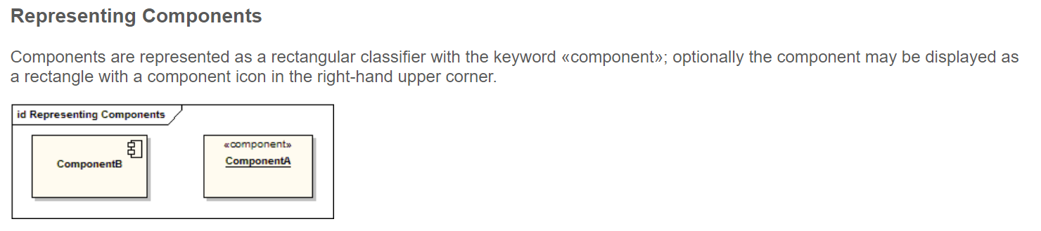
UML – Component Diagram
…a component diagram depicts how components are wired together to form larger components or software systems.

Slide 19
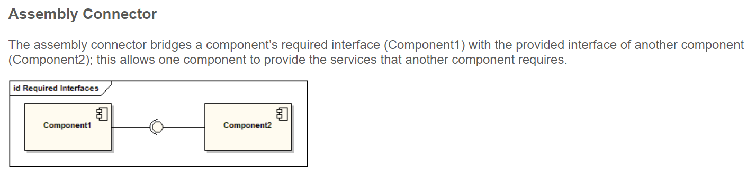
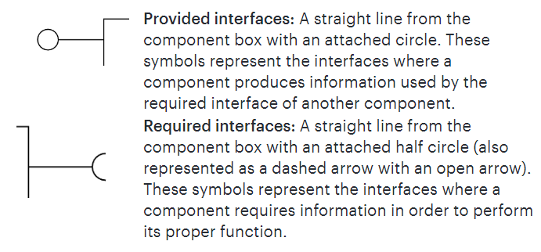
UML – Component Diagram

Slide 20
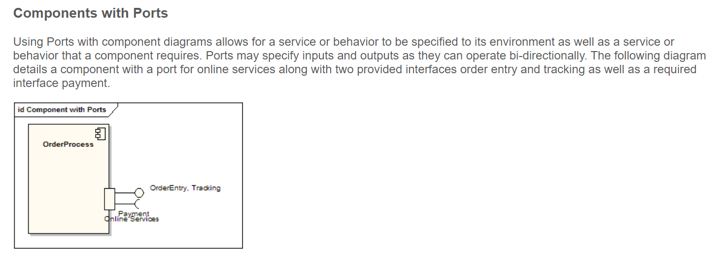
UML – Component Diagram

Slide 21
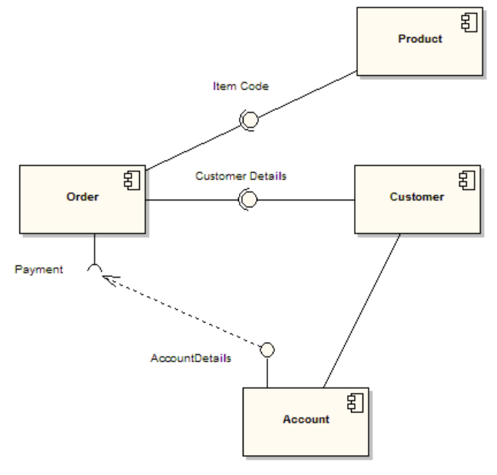
UML Component Diagram

Slide 22
Agenda – Translate Product Requiements into Technical Requirements
1
Technical Specification
2
Top-Down Approach from System Overview to Software Requirements
3
Interface Specification
4
Software Requirement Specification
5
Case Study – BIOTRONIK www.promricheck.com
6
Requirement Engineering in Agile Environment
7
Change Process

Slide 23
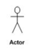
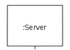
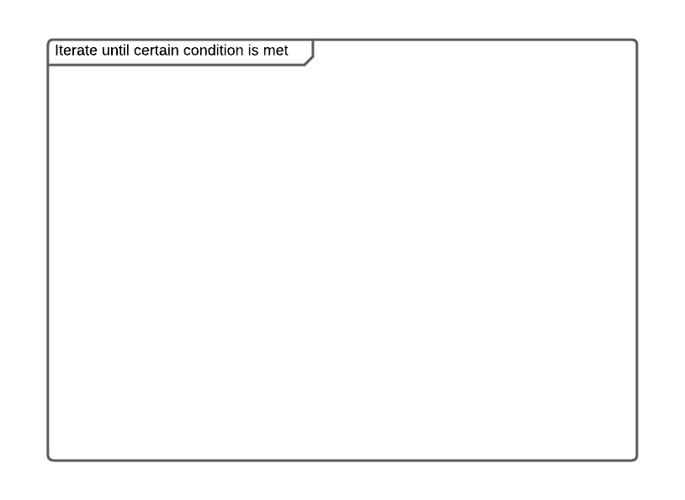
UML – Sequence Diagram
… shows object interactions arranged in time sequence.
A system sequence diagram should specify and show the following:
External actors
Messages (methods) invoked by these actors
Return values (if any) associated with previous messages
Indication of any loops or iteration area
Method name (optional parameter)
Return message
Return message

Slide 24
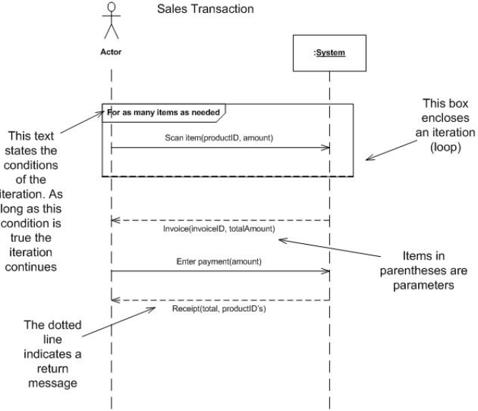
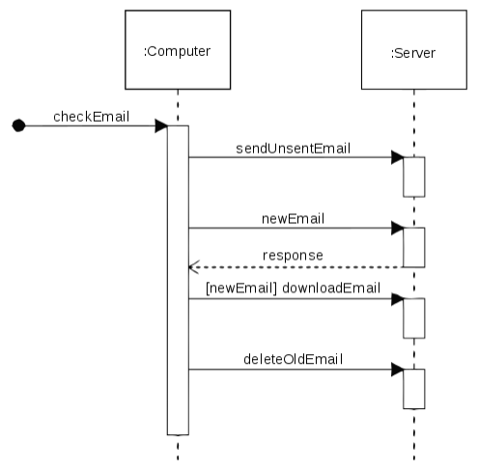
UML Sequence Diagram

Slide 25
Agenda – Translate Product Requiements into Technical Requirements
1
Technical Specification
2
Top-Down Approach from System Overview to Software Requirements
3
Interface Specification
4
Software Requirement Specification
5
Case Study – BIOTRONIK www.promricheck.com
6
Requirement Engineering in Agile Environment
7
Change Process

Slide 26
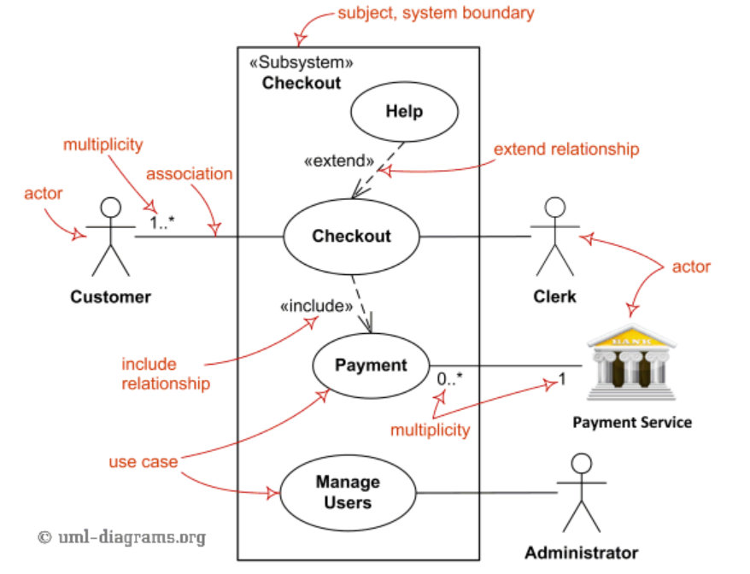
Use Case Diagram
A use case diagram is a graphical depiction of a user's possible interactions with a system

Slide 27
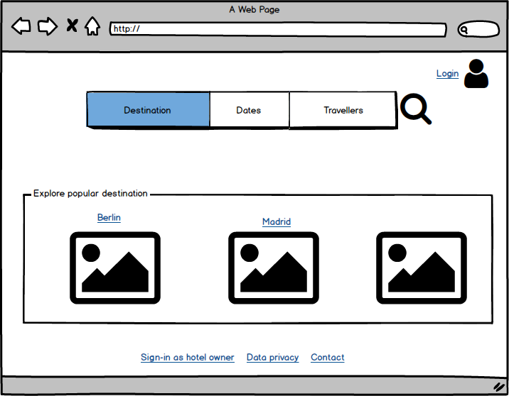

Training – Webshop Hotel Booking
Website
Login
Pick a date
Search for hotel
Search for a destination
Display Landing Page
<<invokes>>
{ if user selected corresp. option}
Display Popular Destinations
<<invokes>>
{ if user selected corresp. option}
Specify travellers
Display Data Privacy
Sign-in as Hotel Manager

Slide 28
Domain Class Model – Class Diagram
… is a type of static structure diagram that describes the structure of a system by showing the system's classes, their attributes, operations (or methods), and the relationships among objects.
Key elements:
Class member (attributes or methods)
Relationships

Slide 29
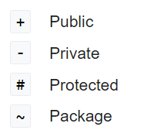
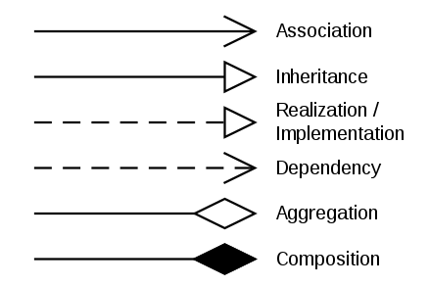
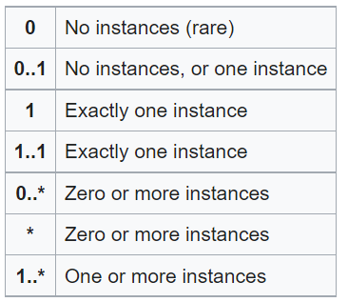
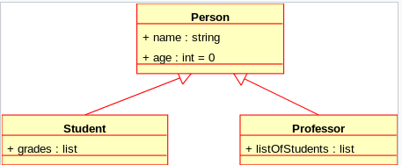
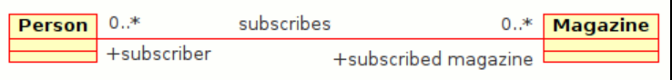
Class Diagram
Visibility of class members Associations Multiplicity

Slide 30
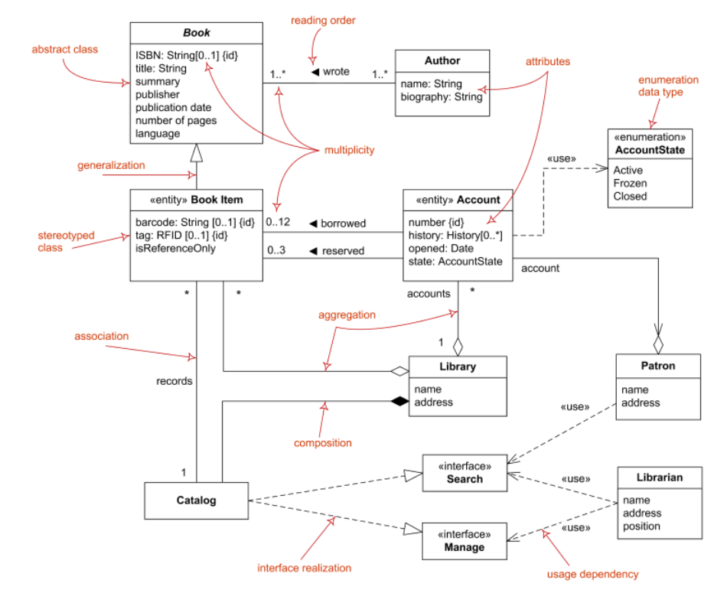
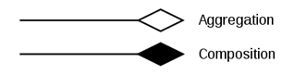
Class Diagram
These are “is-part-of” relationships
Aggregation implies a relationship where the child can exist independently of the parent. Example: Class (parent) and Student (child). Delete the Class and the Students still exist.
Composition implies a relationship where the child cannot exist independent of the parent. Example: House (parent) and Room (child). Rooms don't exist separate to a House.

Slide 31
Domain Class Model – Training: Webshop Hotel Booking
+destination
Booking Request
Destination
Region
+ start data: Date
+ end date: Date
+ name: String[0…1000]
<<is a>>
1..*
1
+travellers
+region countries
1..*
Traveller
<<is a>>
<<is a>>
+ age: Integer [0…150]
1..*
+associated regions
City
1..*
1
Country
+city
Customer
Address
+ surname: String
+ last name: String
+ email: String
+ date of birth: Date
+ payment method: Payment
+ Street: String[0…1000]
1..*
1..*
+invoice address

Slide 32
UML – Activity Diagram
… are graphical representations of workflows of stepwise activities and actions with support for choice, iteration and concurrency.
The most important shape types:
ellipses represent actions;
diamonds represent decisions;
bars represent the start (split) or end (join) of concurrent activities;
a black circle represents the start (initial node) of the workflow;
swimlanes
an encircled black circle represents the end (final node).

Slide 33
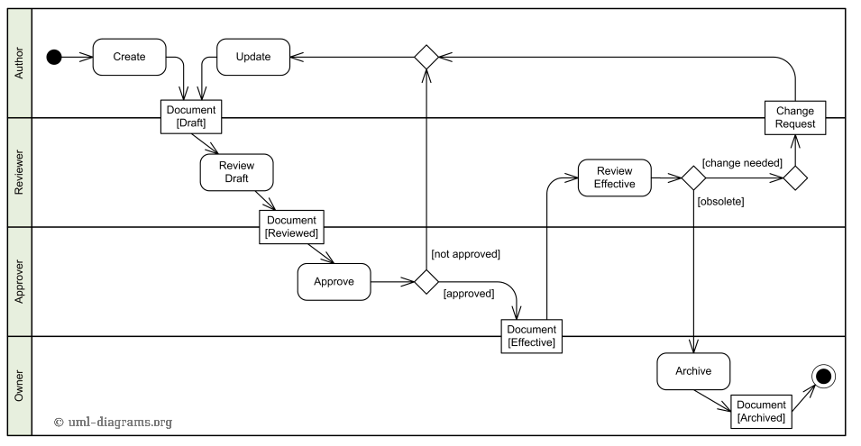
UML – Activity Diagram

Slide 34
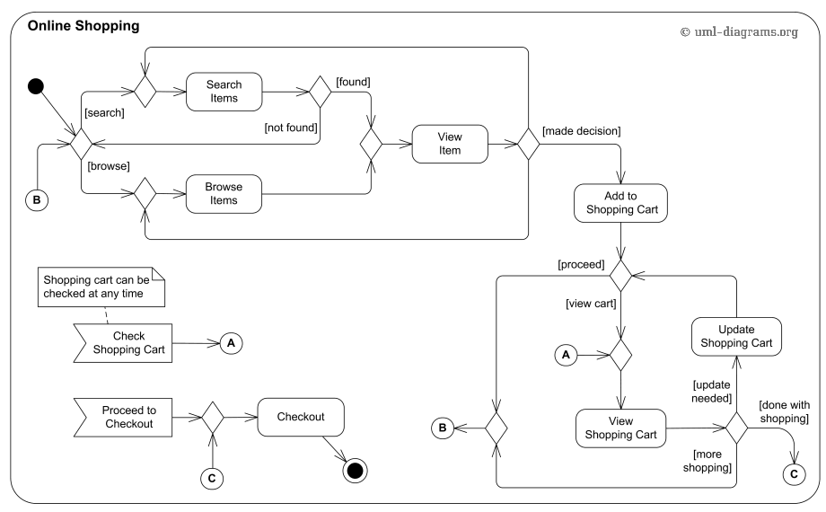
UML – Activity Diagram

Slide 35
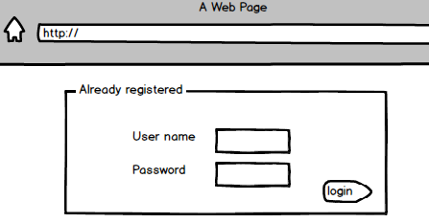
Training – Webshop Hotel Booking
System provides an option to enter user name
System provides an option to login
System provides an option to enter password
User entered user name?
User presses button or enter?
User entered password?
[no]
[no]
[no]
[yes]
[yes]
[yes]
System checks user name
System checks password
System displays user name error message
[no]
[yes]
[yes]
[no]
System displays password error message
Input correct?
Input correct?
System invokes use case “Display User Home Page”

Slide 36
Use Case Templates
Use Case ID | A unique identifier in the docuemnt
Title | The title of the use case
Level | ☒Primary (user goal) ☐Secondary (subfunction)
Short description | Description of what the use case does
Actors | ProMRI information seeker
Input parameters | Input parameter 1
 | Couple of input parameters: lists or strings, integers,instances of domain class
Output parameters | Possible output parameters which could be passed back to the use case invoking this use case
Main use case requirements
MAIN-1 | General requirements which are not related to a specific step (for example password requirements,…)
Main-… | …
Main success scenario
Step 1 | The system does something as the first step
Step 2 | 2nd thing the system does
Step x | …
Variation of step 1: for example an error occurs or the user selects an option,…
Step 1.1 | First step of the variation
Step 1.2 | The 2nd step and so on
Variation of step x:…
Step 3.1 | First step of this variation
Example (the example is optional)
A picture or a wireframe of the GUI (graphical user interface)..

Slide 37
Agenda – Translate Product Requiements into Technical Requirements
1
Technical Specification
2
Top-Down Approach from System Overview to Software Requirements
3
Interface Specification
4
Software Requirement Specification
5
Case Study – BIOTRONIK www.promricheck.com
6
Requirement Engineering in Agile Environment
7
Change Process

Slide 38
Agenda – Translate Product Requiements into Technical Requirements
1
Technical Specification
2
Top-Down Approach from System Overview to Software Requirements
3
Interface Specification
4
Software Requirement Specification
5
Case Study – BIOTRONIK www.promricheck.com
6
Requirement Engineering in Agile Environment
7
Change Process

Slide 39
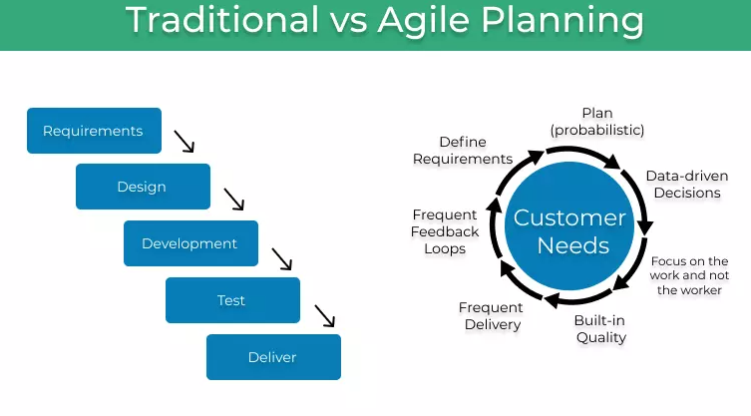
Agile Project Management

Slide 40
Agile Development
Iterative and incremental software development since the 1950s
Popularized in he beginning of this millennium
Broad range of software development frameworks including Scrum and Kanban

Slide 41
The Manifesto for Agile Software Development is based on twelve principles
Customer satisfaction by early and continuous delivery of valuable software.
Welcome changing requirements, even in late development.
Deliver working software frequently (weeks rather than months)
Close, daily cooperation between bussiness people and developers
Projects are built around motivated individuals, who should be trusted
Face-to-face conversation is the best form of communication (co-location)
Working software is the primary measure of progress
Sustainable development, able to maintain a constant pace
Continuous attention to technical excellence and good design
Simplicity—the art of maximizing the amount of work not done—is essential
Best architectures, requirements, and designs emerge from self-organizing teams
Regularly, the team reflects on how to become more effective, and adjusts accordingly

Slide 42
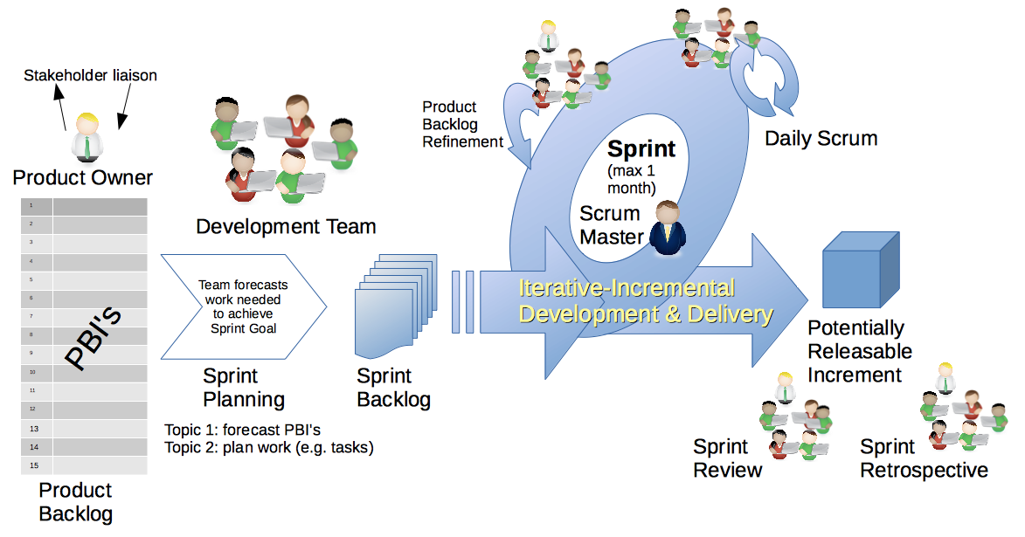
Agile software development

Slide 43
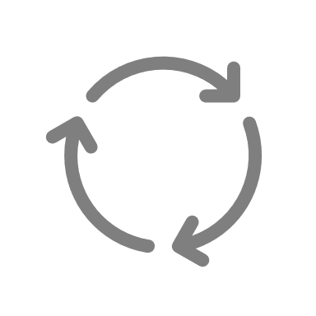
Agile software development
Stage i
Stage i+1
Stage i+m
…
Release Candidate (RC1)
RC3
=
Release i
Release Candidate (RC1)
RC3
=
Release i+1
Release Candidate (RC1)
RC3
=
Release i+m
RC2
RC2
RC2
Sprint Critical
Sprint Feature
Sprint Stable
Sprint Critical
Sprint Feature
Sprint Stable
Sprint critical
Sprint Feature
Sprint Stable
Release of SRS (Rev. X_{a})
Include features for stage i
Release of SRS (Rev. X_{a+1})
Include spec bug fixes for stage i
Release of SRS (Rev. X_{c})
Include features for stage i+m
Release of SRS (Rev. X_{c+1})
Include spec bug fixes for stage i+m

Slide 44
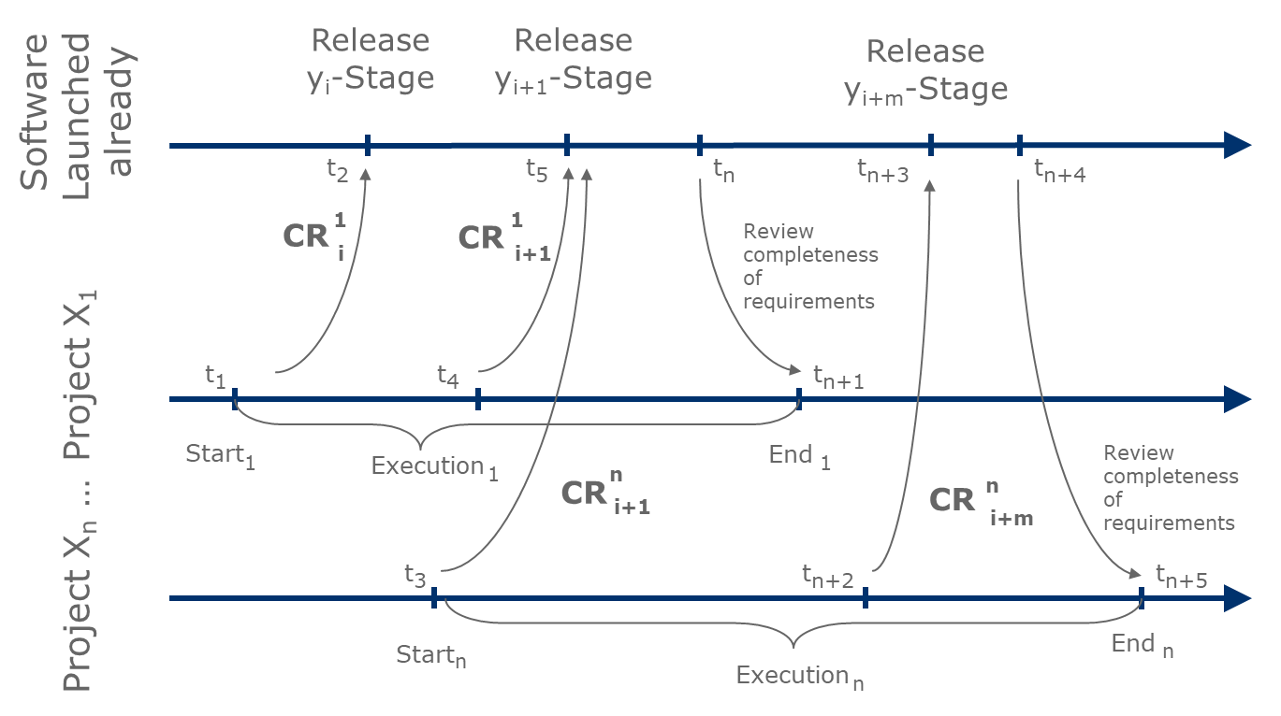
Agile software development
*CR… change request: a change of the software or a product and all corresponding activities

Slide 45
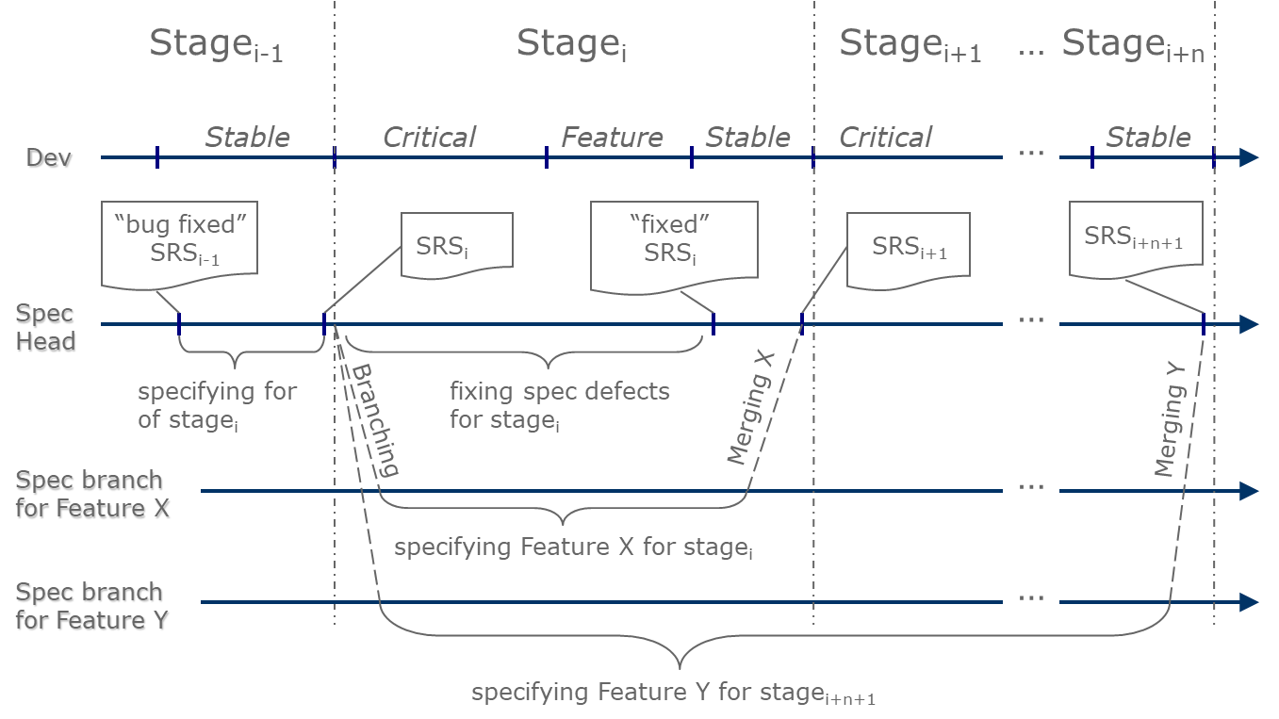
Requirement Specification in Branches

Slide 46
Agenda – Translate Product Requiements into Technical Requirements
1
Technical Specification
2
Top-Down Approach from System Overview to Software Requirements
3
Interface Specification
4
Software Requirement Specification
5
Case Study – BIOTRONIK www.promricheck.com
6
Requirement Engineering in Agile Environment
7
Change Process

Slide 47






Change Management Process
Documents are part of a product (describe the requirements and demands to a product)
Thus if the product must be changed the documents must be adapted correspondingly
CR
001
PRD
Rev i
PRD
Rev i+1
TSD
System
Rev x
TSD
System
Rev x+1
Idea for product update
Documentation of product update in a change request (CR)
Approval by change board or project steering committee (stakeholder or delegates of stakeholders)
Create new revision of PRD
Document approvers must sign Rev. i+1
Create new revision of technical specifications TSD, ICD or SRS if necessary
Update tracing matrix
Doc approvers must sign Rev. x +1

Slide 48
Change Management Process
Change Management – company wide
Criteria can be defined for fast and full track changes
Fast/ Full track decision criteria
Implementation effort: Example - small effort (<x hours) -> 1 point/ medium effort (< y hours) -> 2 points/ high effort (> y hours) -> 3 points
Complexity: Example – group of i people required -> 1 point/ group of j > i people required -> 2 points/ …
Invest: Example – no invest -> 0 points/ > Certain amount of Euros 1 points/ …
…
All people who were identified to execute tasks for this change decide on thecriteria above
if more than a pre-defined number of points are exceeded
=> Full Track Change -> CR must be approved by stakeholders (or delegates)
Otherwise Fast Track Change
=> the people can perform the changes and tasks without getting further approval from stakeholders

Slide 49
Change Management Process
Change Management – project related
Project Steering Comittee (certain stakeholders, ususally project sponsor, product management, development, manufacturing) must approve changes
At the start of a project criterias might be defined that project team can decide for changes on thier own (for example if budget change is within a certain range and if the idea does not result in a significant system change, e. g. budget change is within ±5% of originally approved budget)
After approval of a change, the PRD or TRD or ISD or SRS are adapated and a new revision is created
The new revisions must be signed by all document approvers

Slide 50
Literature & References
Kent Beck; James Grenning; Robert C. Martin; Mike Beedle; Jim Highsmith; Steve Mellor; Arie van Bennekum; Andrew Hunt; Ken Schwaber; Alistair Cockburn; Ron Jeffries; Jeff Sutherland; Ward Cunningham; Jon Kern; Dave Thomas; Martin Fowler; Brian Marick (2001). "Principles behind the Agile Manifesto". Agile Alliance. Archived from the original on 14 June 2010. Retrieved 6 June 2010.
"UML 2.5.1 specification". Omg.org. Retrieved 24 October 2018.

Slide 51
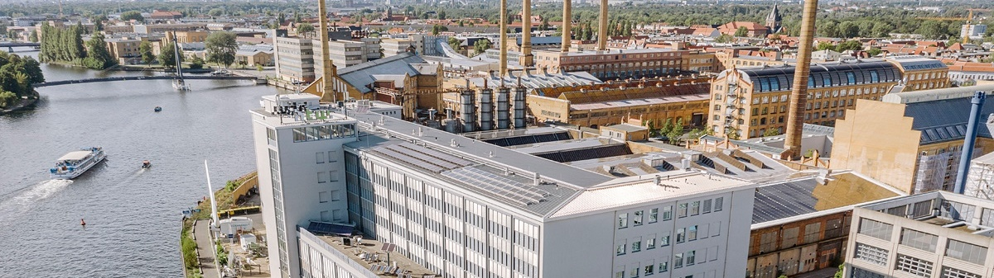
Thank you!

Slide 52
www.htw-berlin.de

